Slide 1
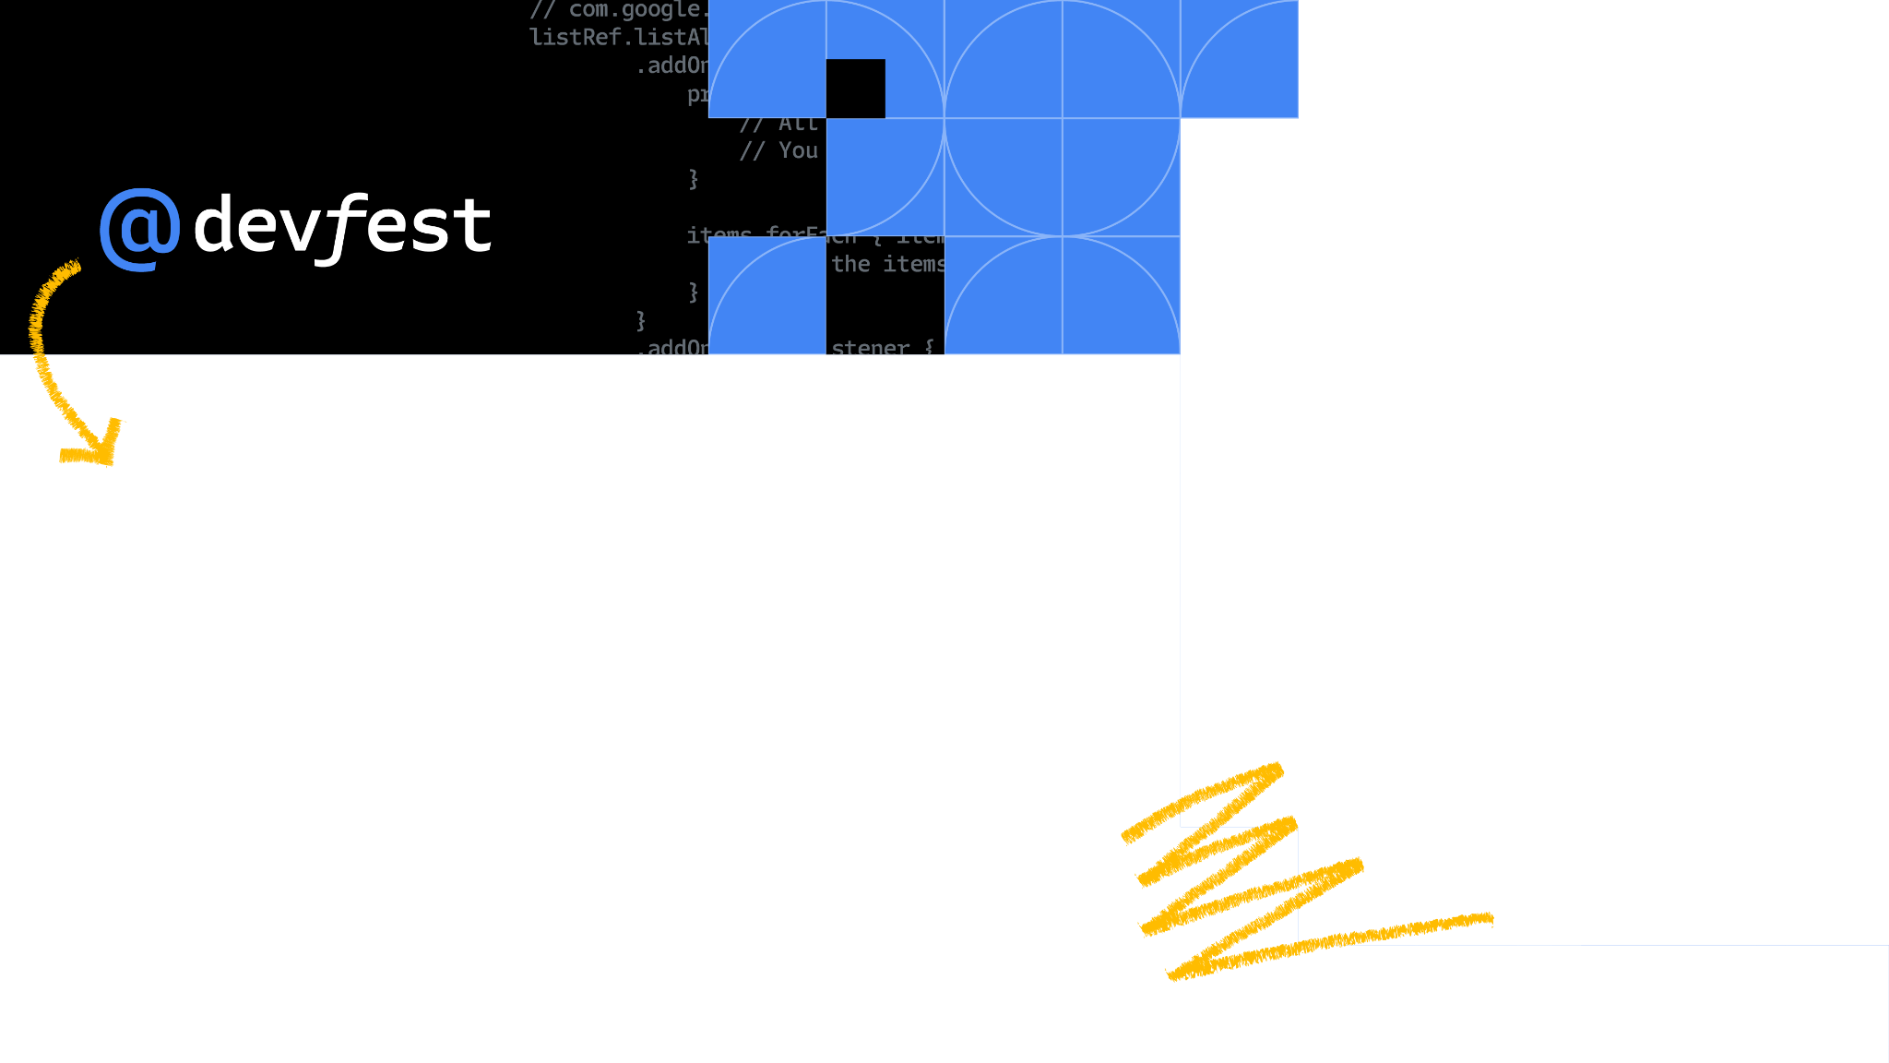


Generative Models the new Era of AI
Email: aliosama8399@gmail.com
LinkedIn: ali osama ali
Assiut

Slide 3
Agenda
01 Introduction 08 Stable Diffusion
02 What is Generative Models 09 Code Explanation
03 Types Of Generative Models
04 Style Transfer
05 Generative Adversarial Networks (GAN)
06 Variational Autoencoder
07 StyleGan

Slide 4
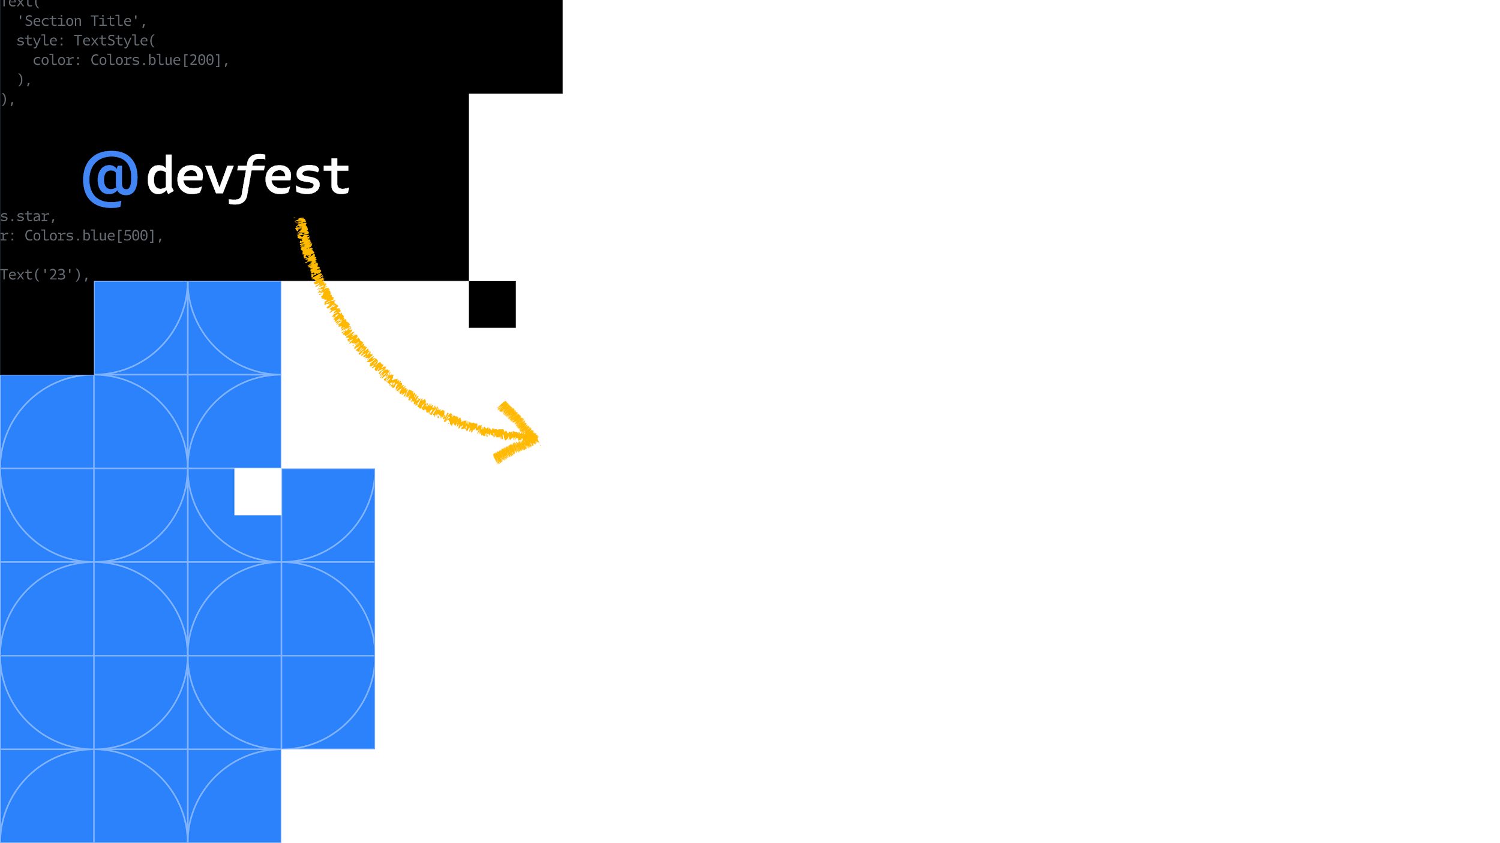
Introduction
Assiut

Slide 5
Introduction
Fast Question:What is Exactly Machine Learning ?
Notes:
A model trained on poetry will predict output that’s….

Slide 6
“The field of study that gives computers the ability to learn without being explicitly programmed”
Arthur Samuel

Slide 7
Introduction
What are NLP,CV,DL?
Notes:
poetic

Slide 8
Introduction
NLP (Natural Language Processing): NLP teaches computers to understand and use human language.
CV (Computer Vision): CV helps computers "see" and comprehend images or videos.
DL (Deep Learning): DL is a type of machine learning using neural networks with multiple layers.
Notes:
A model trained on poetry will predict output that’s….

Slide 9
What is Generative Models?

Slide 10
History
Generative models are a class of machine learning models designed to understand and mimic the underlying patterns and structures within a given dataset. Unlike discriminative models that focus on learning the boundary between different classes in the data, generative models aim to capture the entire data distribution. In other words, their primary goal is to generate new data points that resemble the examples from the training set.
Notes:
poetic

Slide 11
History
The roots of GenAI trace back to the concept of machine learning. When scientists and researchers introduced machine learning in the late 1950s, they explored the concept of using algorithms to create new data.
One of the first examples of GenAI was the Markov Chain, a statistical model that could be used to generate new sequences of data based on input.
But despite some advances, the computational power and data resources needed for systems like this to flourish weren't yet available.
Machine learning only began to shine in the 1990s and 2000s, when advanced hardware and digital data became more widely available.
Notes:
poetic

Slide 12
Types Of Generative Models

Slide 13
Types Of Generative Models
Style Transfer
Variational Autoencoders (VAEs):
Generative Adversarial Networks (GANs)
WaveNet
GPT-2 and GPT-3 (2019, 2020)
DALL-E (2022)
ChatGPT (2022)
GPT-4 (2023)
Diffusion models.
Notes:
poetic

Slide 14
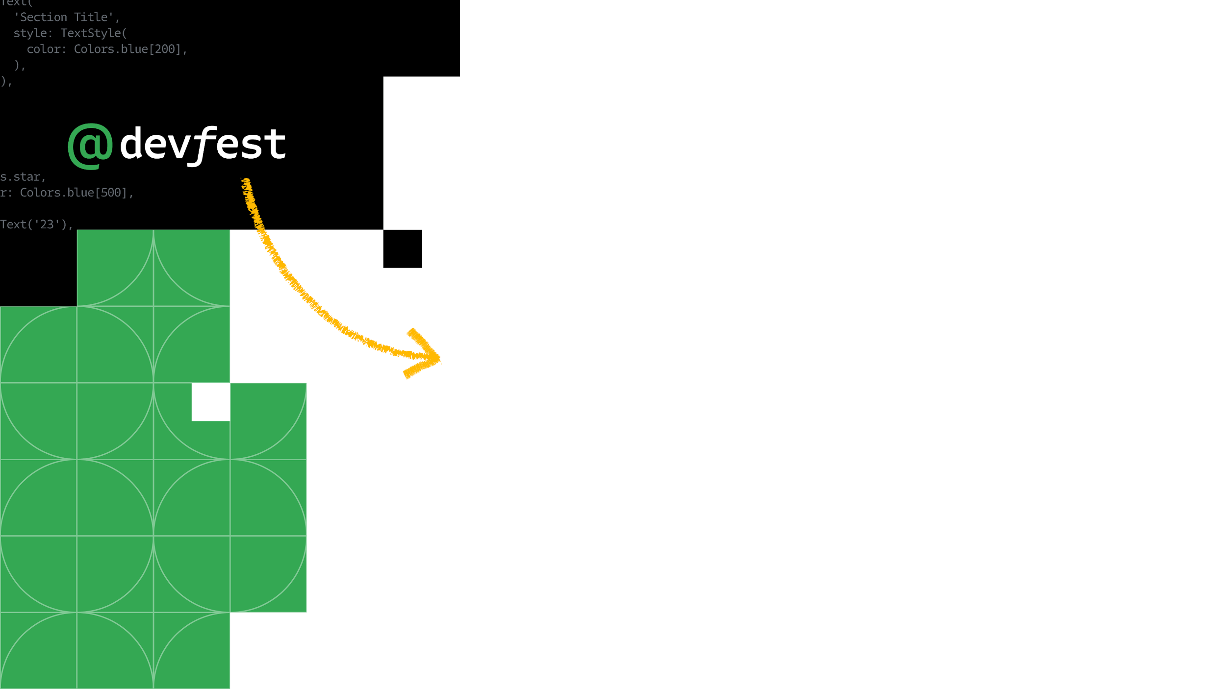
Style Transfer
Assiut

Slide 15
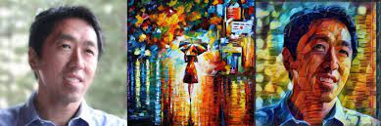
Style Transfer
Style Transfer is a technique in computer vision and graphics that involves generating a new image by combining the content of one image with the style of another image. The goal of style transfer is to create an image that preserves the content of the original image while applying the visual style of another image.
Notes:
poetic

Slide 16
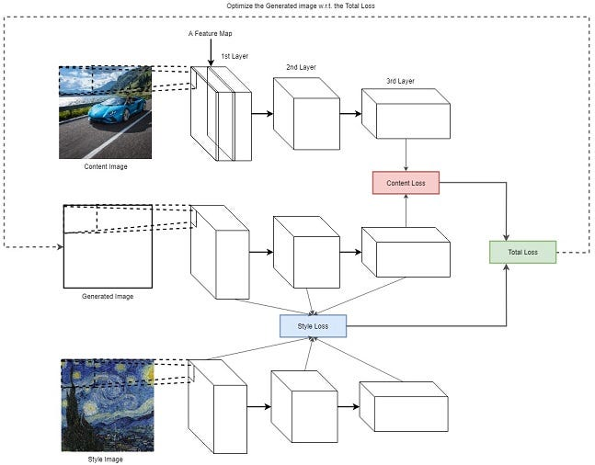
Style Transfer
Feature Extraction:
Both the content and style images are passed through a pre-trained convolutional neural network (CNN). This network is used to extract features from different layers, capturing both low-level and high-level information.
Content and Style Representation:
Features from one or more intermediate layers of the network are used to represent the content of the content image and the style of the style image separately. This is usually done by computing the Gram matrix for style representation.
Notes:
poetic

Slide 17
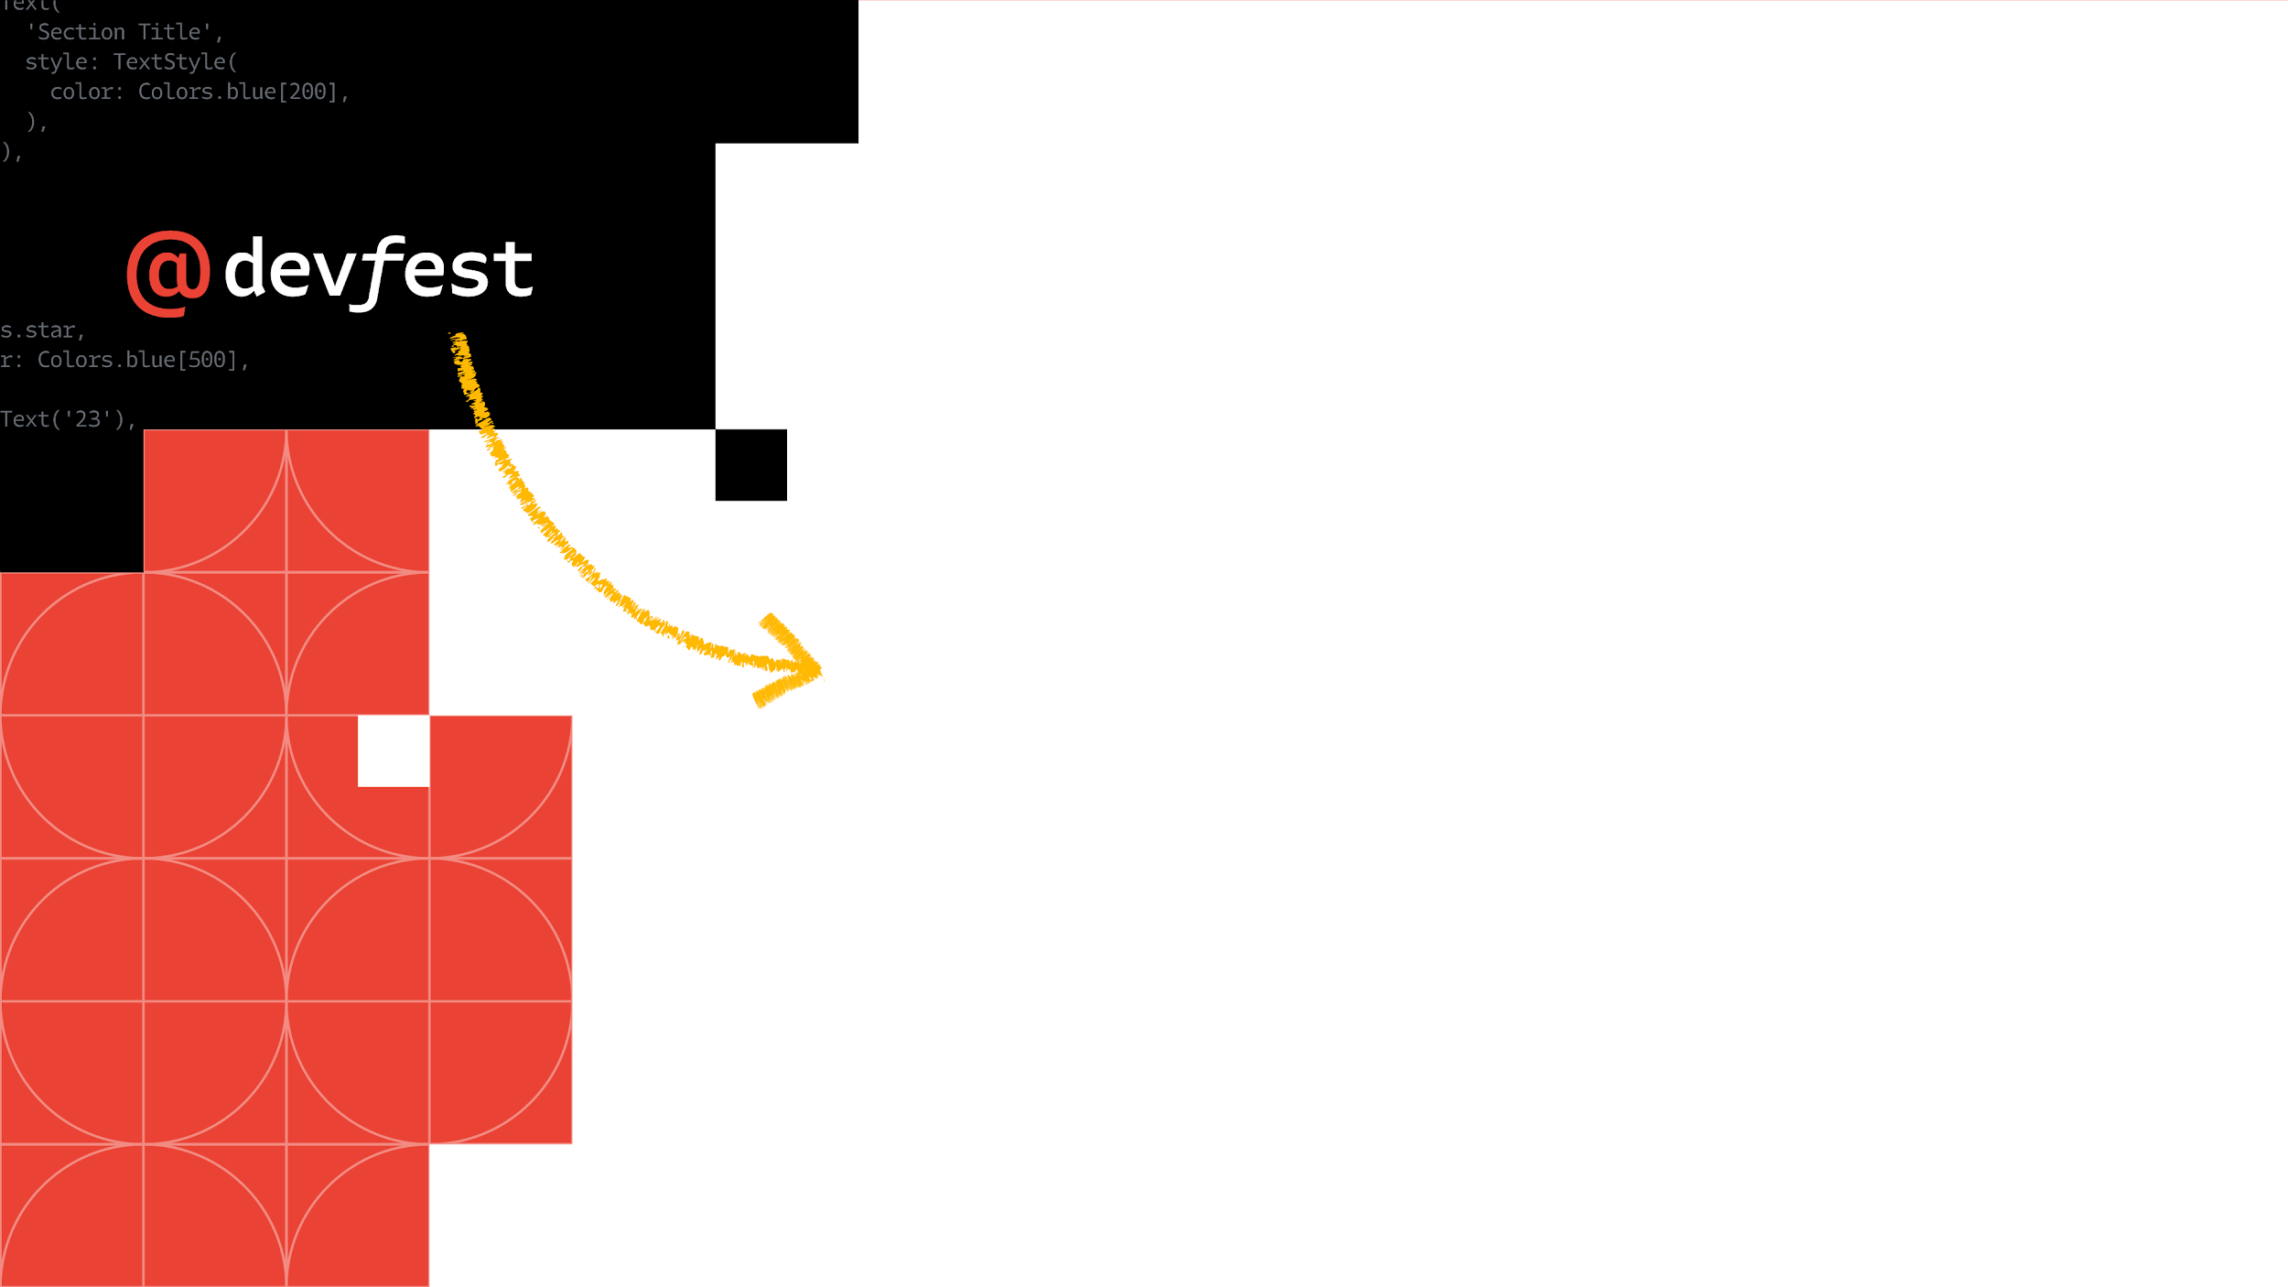
Generative Adversarial Networks (GAN)
Assiut

Slide 18
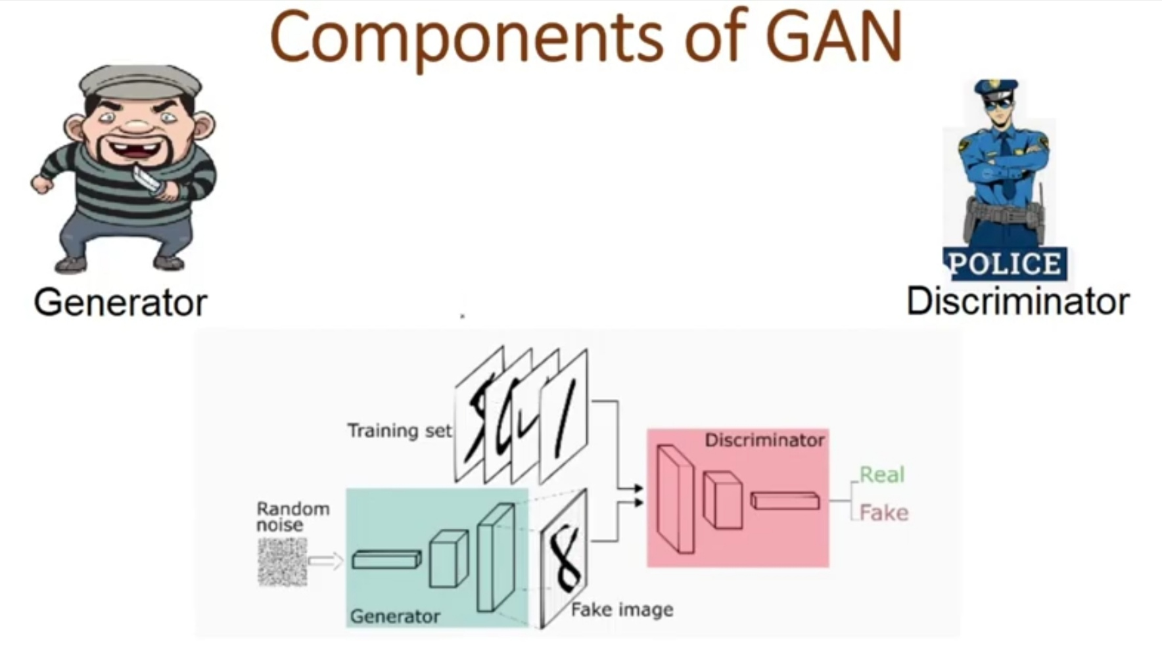
Types Of Generative Models
Generative Adversarial Networks (GANs):
Description: GANs consist of a generator and a discriminator network, trained simultaneously through adversarial training. The generator creates samples, and the discriminator distinguishes between real and generated samples. The competition between them improves the realism of the generated data.
Applications: Image synthesis, style transfer, data augmentation.
Notes:
poetic

Slide 19
Variational Autoencoder

Slide 20
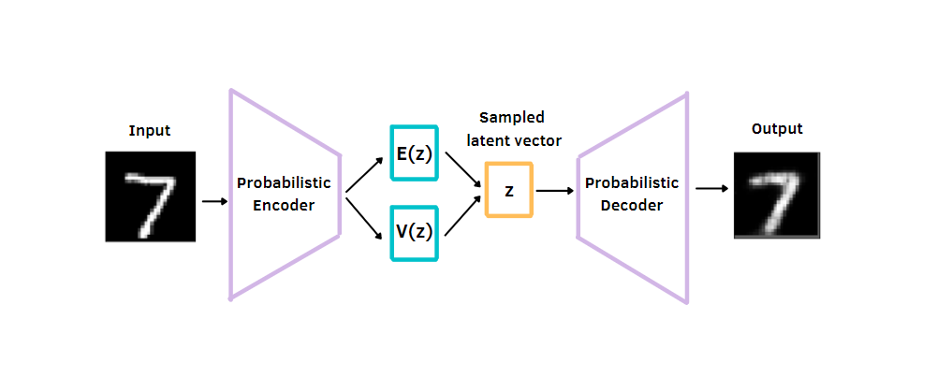
Types Of Generative Models
Variational Autoencoders (VAEs):
Description: VAEs build upon the concept of autoencoders but introduce probabilistic principles into the latent space. The encoder produces not only a fixed-size encoding but also a probability distribution over the latent space.
Significance: VAEs enable the generation of diverse samples by sampling from the learned probability distribution in the latent space.
Notes:
poetic

Slide 21
Diffusion Model
Assiut

Slide 22
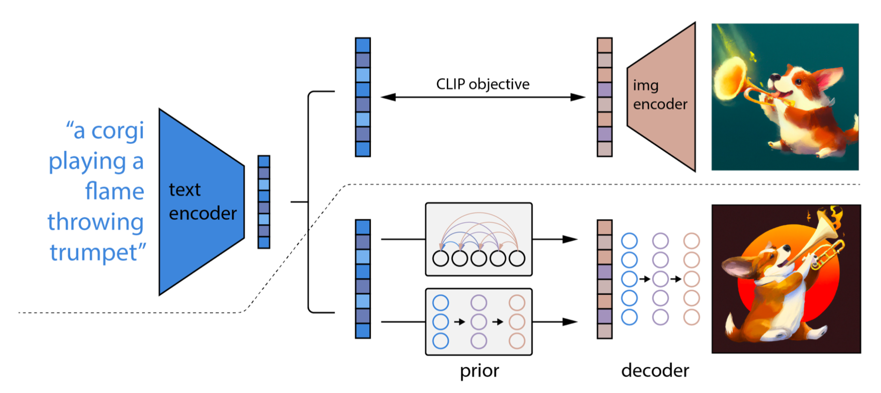
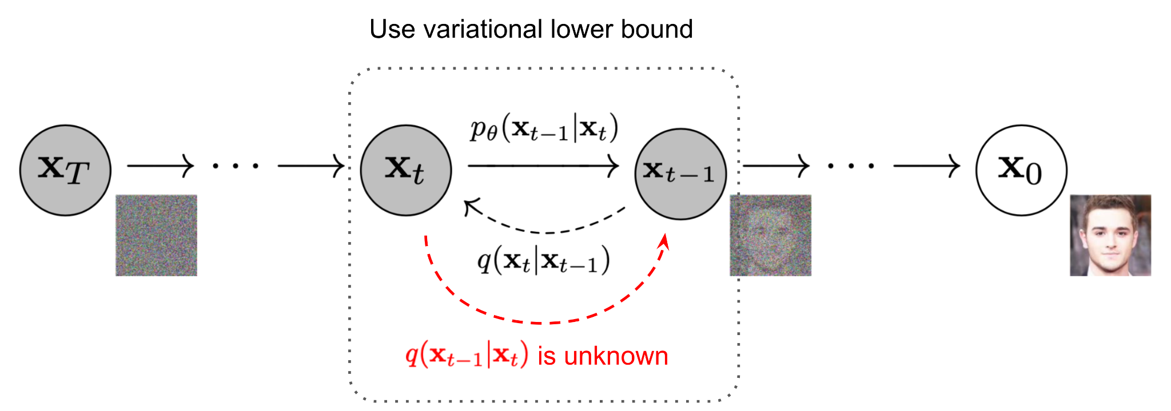
Types Of Generative Models
Diffusion models.
Diffusion models are fundamentally different from all the previous generative methods. Intuitively, they aim to decompose the image generation process (sampling) in many small “denoising” steps.
They take the input image ​and gradually add Gaussian noise to it through a series of steps. We will call this the forward process
Afterward, a neural network is trained to recover the original data by reversing the noising process.
Notes:
poetic

Slide 23
StyleGan
Assiut

Slide 24
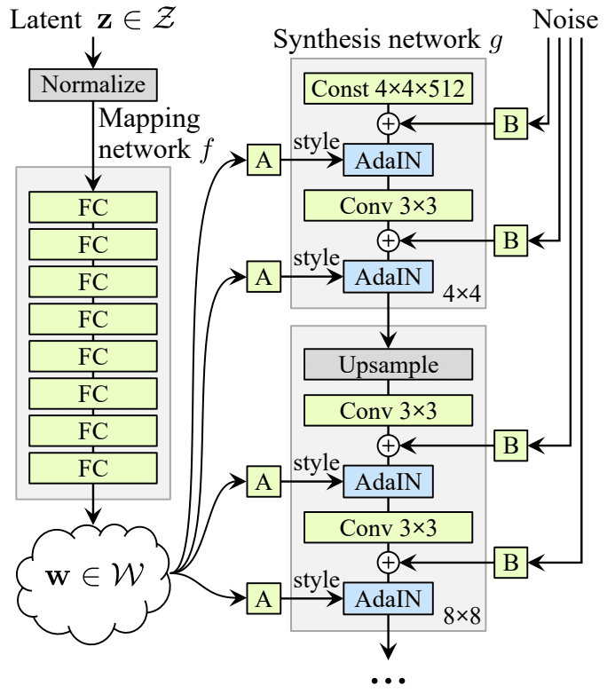
Style GAN
alternative generator architecture for generative adversarial networks, borrowing from style transfer literature. The new architecture leads to an automatically learned, unsupervised separation of high-level attributes (e.g., pose and identity when trained on human faces) and stochastic variation in the generated images (e.g., freckles, hair), and it enables intuitive, scale-specific control of the synthesis. The new generator improves the state-of-the-art in terms of traditional distribution quality metrics, leads to demonstrably better interpolation properties, and also better disentangles the latent factors of variation. To quantify interpolation quality and disentanglement, we propose two new, automated methods that are applicable to any generator architecture. Finally, we introduce a new, highly varied and high-quality dataset of human faces.
Notes:
poetic

Slide 25
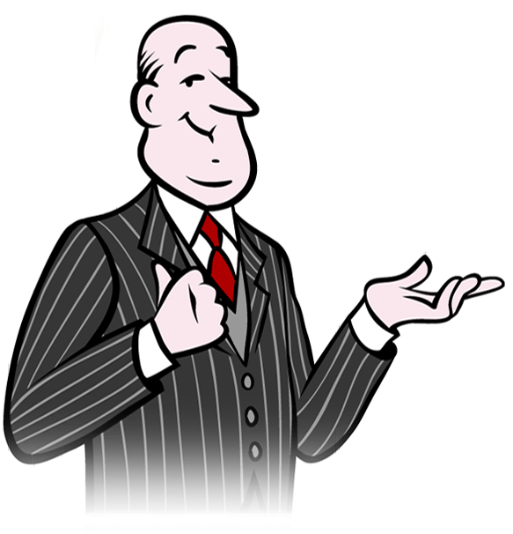
Code Explanation.
Lets build it!
Assiut

